Slide 1
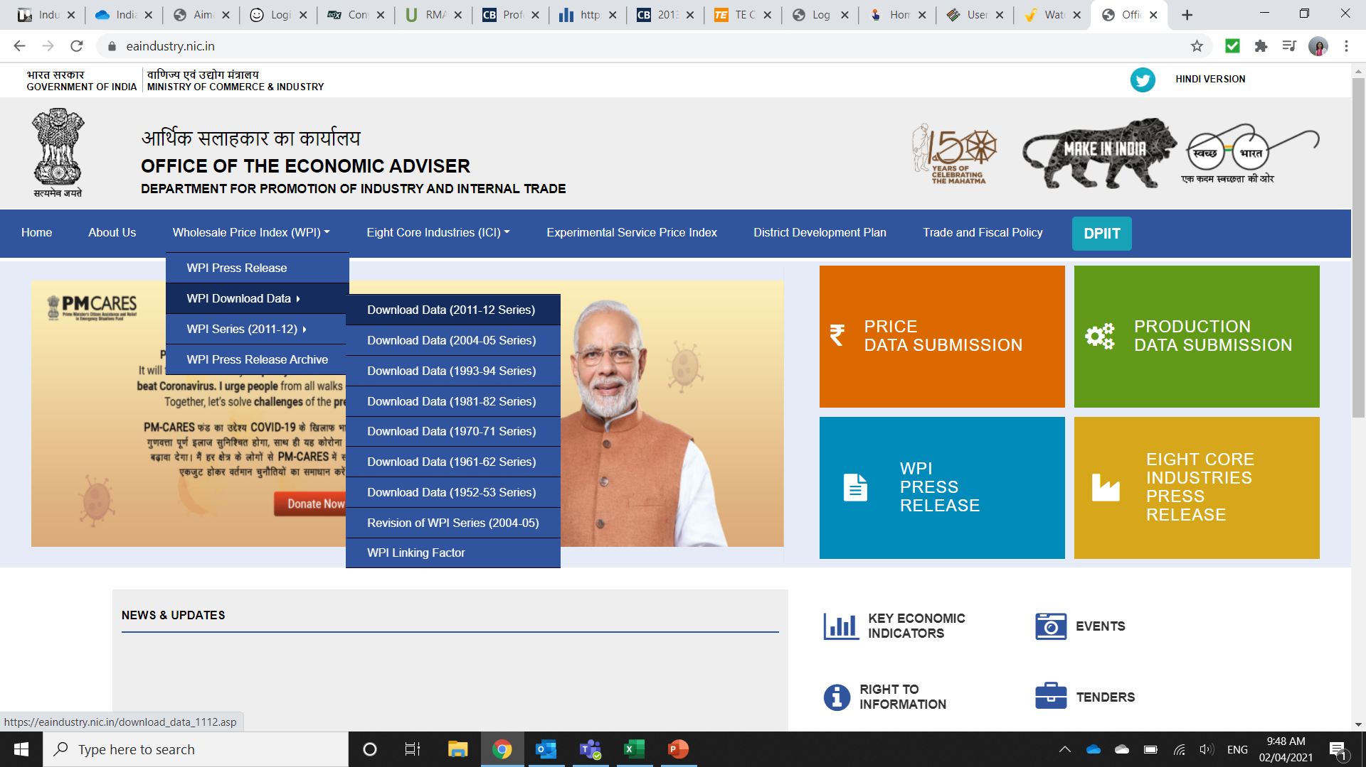
Procedure to obtain PPI data for India
Go to:
Under “Wholesale
Price Index (WPI)” , choose the “WPI Download Data” > “Download Data (2011-12 Series)
https://eaindustry.nic.in/

Slide 2
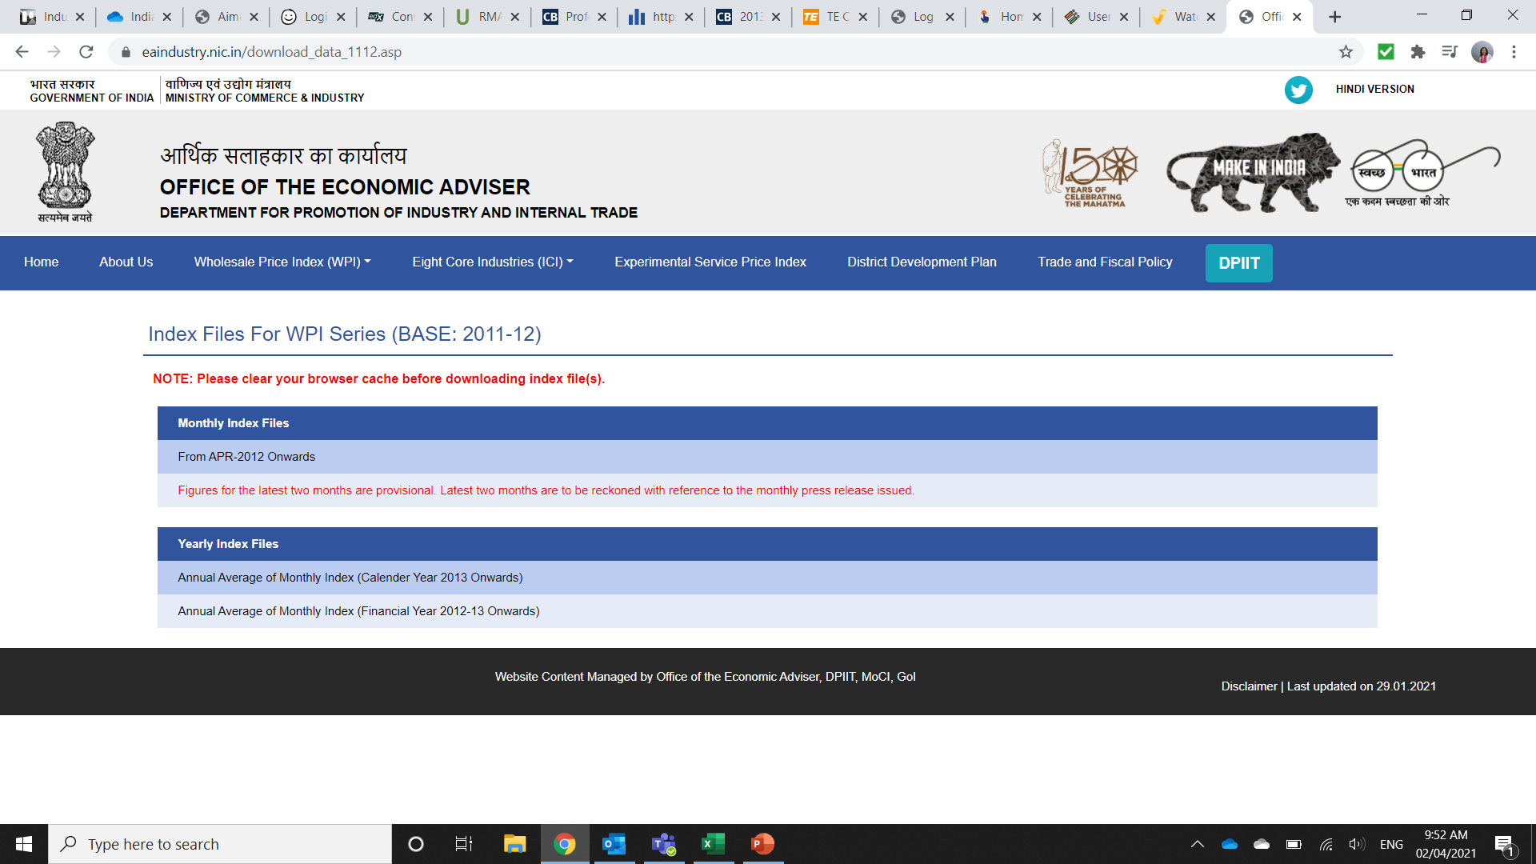
Procedure to obtain PPI data for India
Under Monthly Index Files, choose From “APR-2012 Onwards”

Slide 3
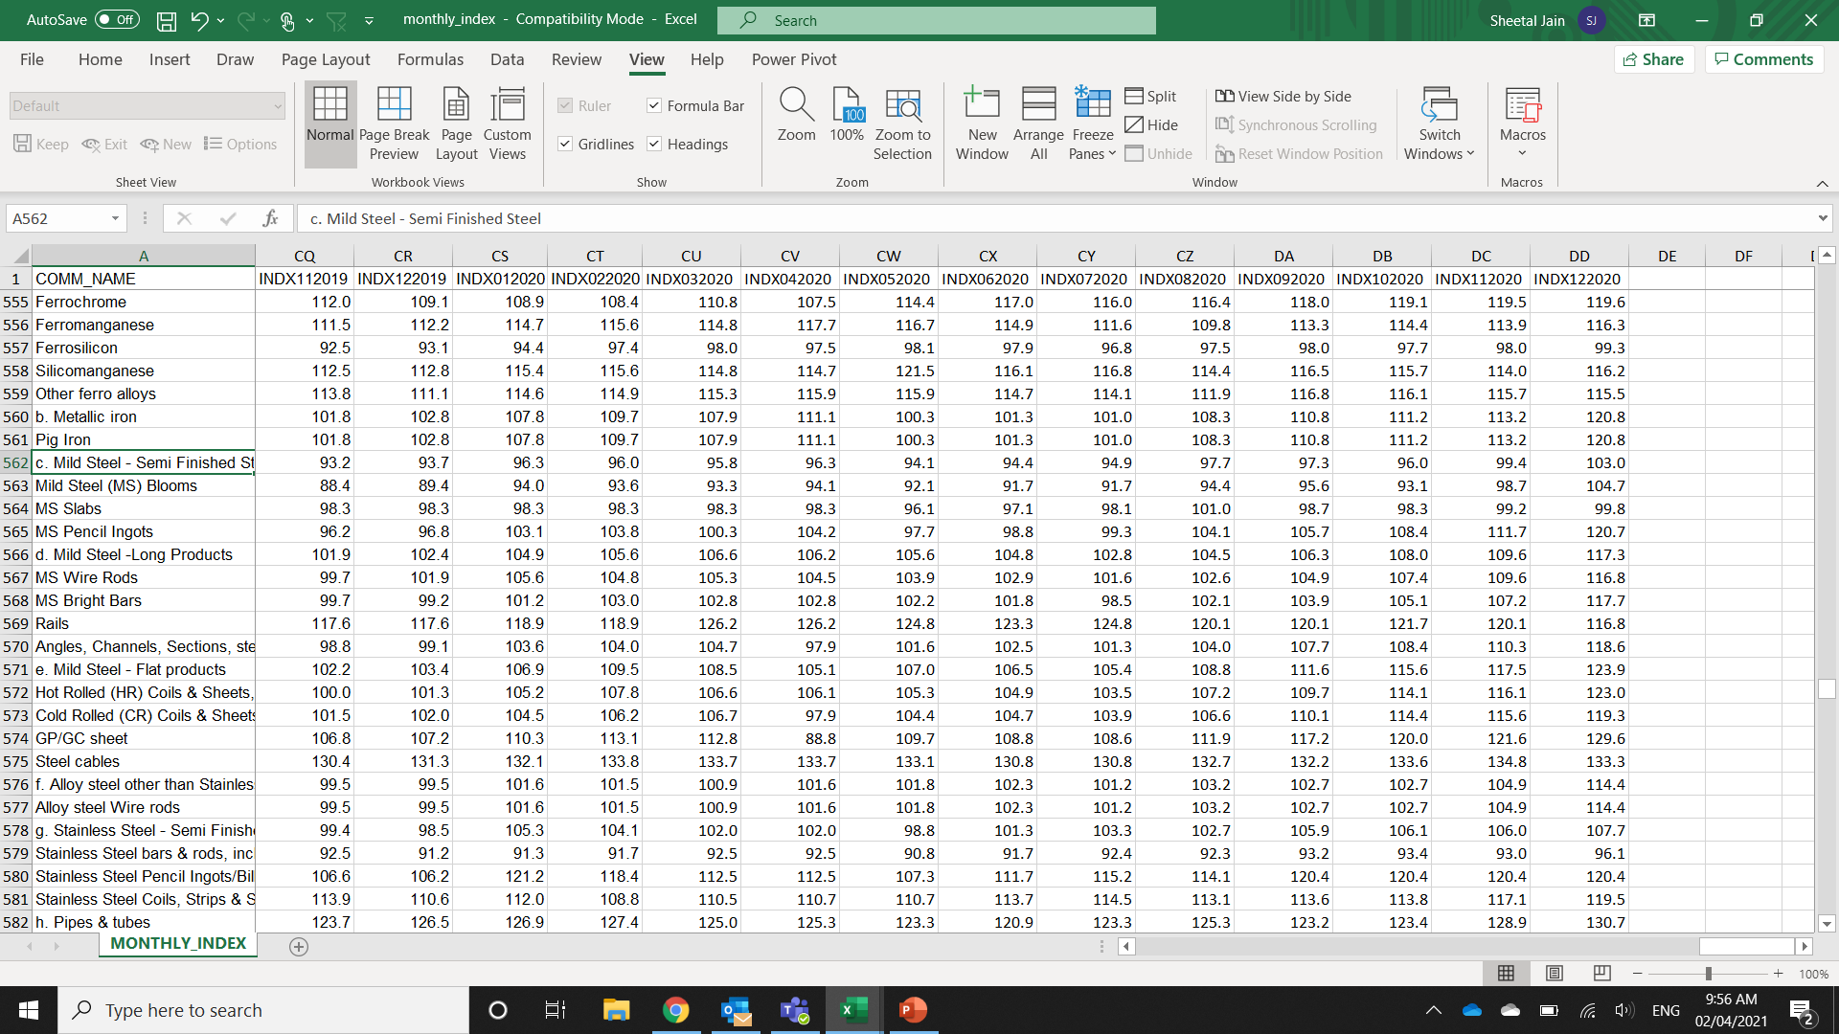
Procedure to obtain PPI data for India
In the downloaded excel, search for commodity name in Column A. In this e.g., “Mild Steel”
Corresponding WPI data is available month wise

